Slide 1


Slide 2
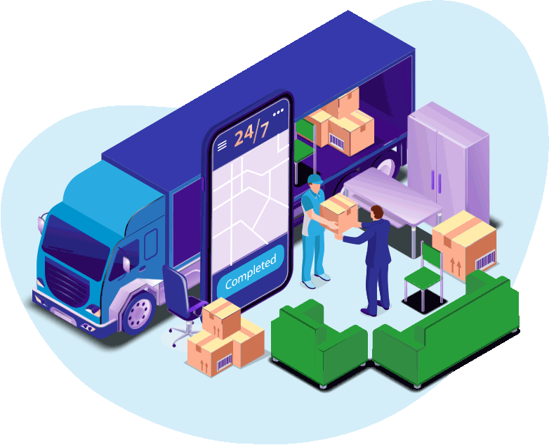
Question to improve
Why can't factories and truck users get rid of companies that prevent them from increasing their profits

Slide 3

Truber’s main goals
Freelance jobs to provide flexibility
Reducing the fees paid by companies to logistics institutions
Adjust the amount of workers

Slide 4
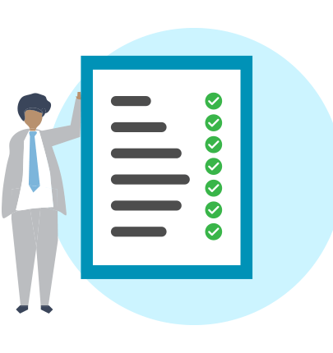
Functional Requirements
The system shall allow users to message between each other.
The system should allow truck drivers and companies to register and create their profiles with essential information such as name, contact details, and payment details.
The system should allow employers to select multiple drivers for 1 job.
The system should calculate the estimated arrival time for the driver to pick the packages.
System should show all the details about the contract like distance of driver etc.

Slide 5
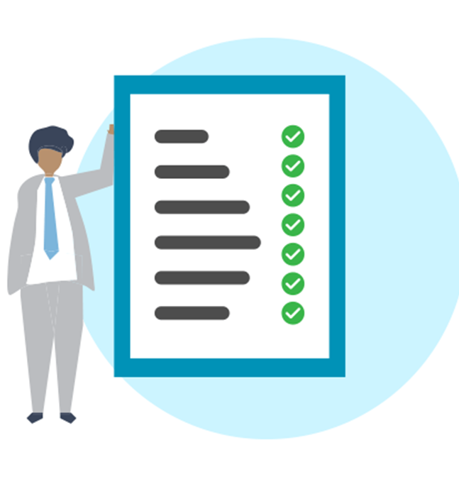
Functional Requirements
The system should allow employers to rate and see comments about drivers.
The system should accept driver’s licenses to approve if the driver is capable of the job.
The system must provide a job board that displays available jobs and allows truckers to apply for them.
The system should automatically calculate and deduct a commission fee from each completed job, which will be payable to the platform owner.

Slide 6

Non-Functional Requirements
The System should require at least 1GB of free space.
The System should open any page in less than 15 seconds.
The system should use Google maps services to navigate the contract.
The System should be available 24/7.
The System should support English & Spanish & Turkish languages.
The System should support Edge Browser, Chrome Browser, Firefox Browser.

Slide 7

Stakeholders
Development Team
Truck Owners
Company Managers
Investors
Competitors
Turkish Government

Slide 8

Mobile Developer

Slide 9

Security Engineer

Slide 10

QA Engineers

Slide 11

Cloud Engineers

Slide 12

Software Process Model
Agile is an iterative approach to project management and software development that helps teams deliver value to their customers faster and with fewer headaches. It involves breaking the project into several phases and emphasizes continuous collaboration with stakeholders, allowing for constant improvement throughout the development cycle.

Slide 13
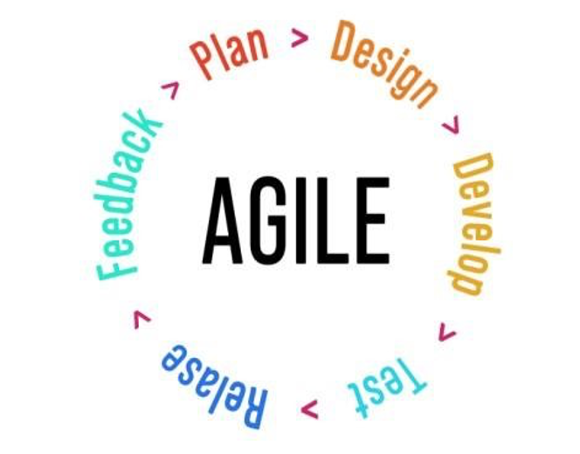
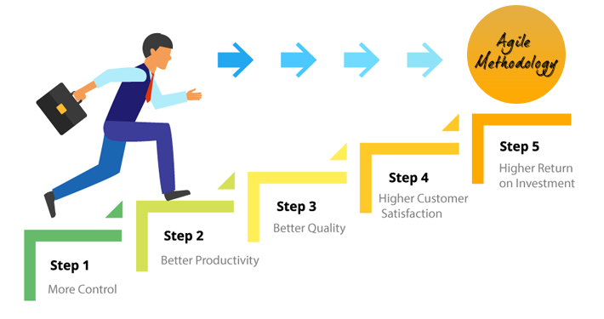
Software Process Model – Agile Methodology
Cyclic process of planning, executing, and evaluating
Self-organizing team that learns and grows over time
Active involvement of the client throughout the development process
Alignment of the product with market realities
Preparation for post-graduation careers in software development

Slide 14
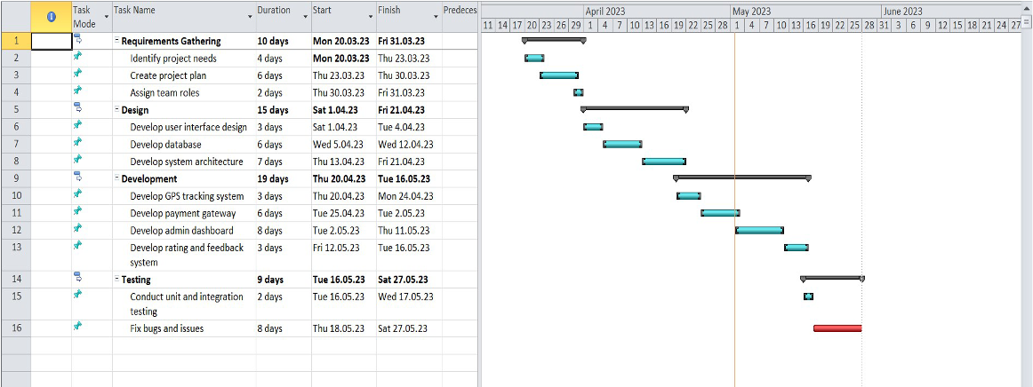
Schedule and Effort

Slide 15


Measurements
Identified measurements:
The quickness of the current job status
Number of truck drivers and companies
Number of errors and bugs occurred if development phase

Slide 16

Measurements
Measurement storage and collection
Number of truck drivers
Number of hours, errors, and bugs
Job activity and ratings
Planning efficiency between workers and company owners
Launching time
Number of users
Required training duration
Time spent on development and testing
Income from completed jobs

Slide 17
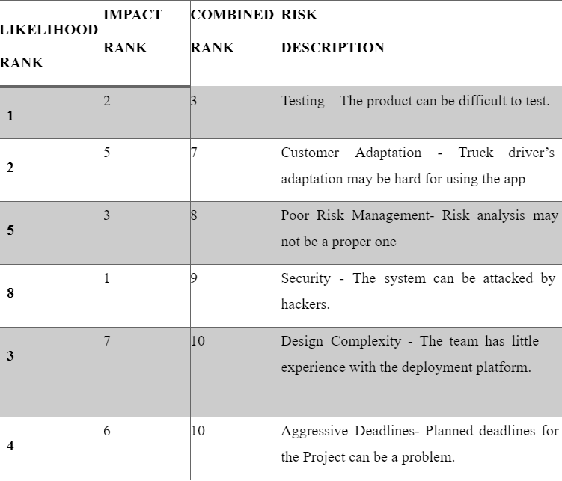

Slide 18

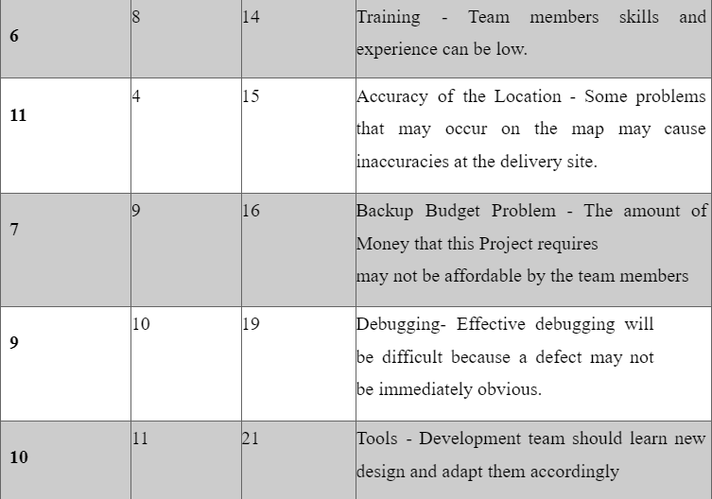

Slide 19
Project Needs | Software Needs
Web app development
GPS integration
Admin dashboard
Rating system
Applicable Payment

Slide 20
Project Needs | Hardware Needs
GPS devIces
DevIces
Server
Computer

Slide 21
Project Needs | Support Needs
TechnIcal support
Customer support
Regulatory support

Slide 22

TOOLS | Task Control Systems

Slide 23



Jira
Trello
Asana
Ora

Slide 24

TOOLS | IDEs

Slide 25



PHPStorm
Visual Studio Code
Net Beans
Eclipse

Slide 26

TOOLS | Database Management Systems

Slide 27




Slide 28
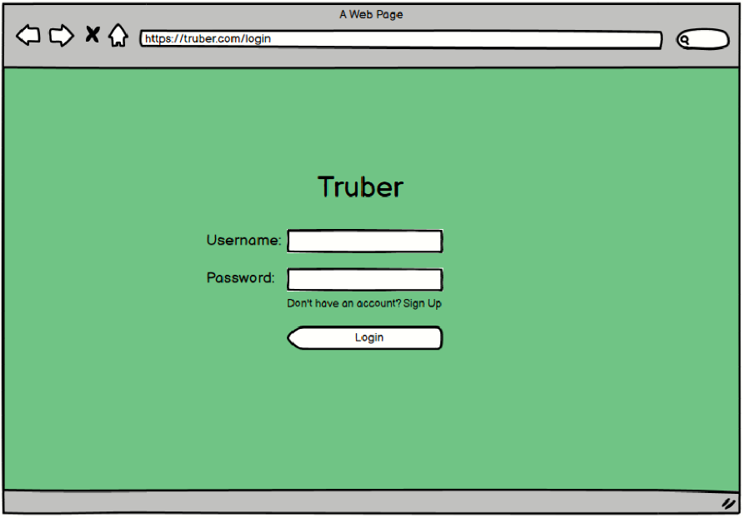
GUI | Login Screen

Slide 29
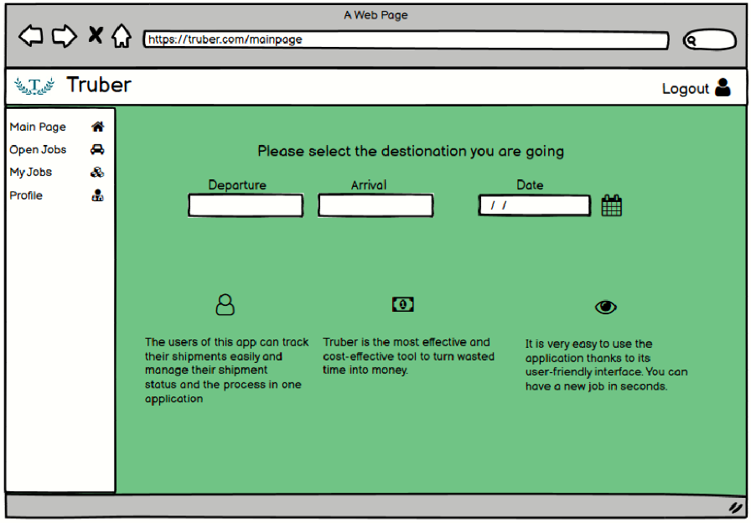
GUI | Main Page

Slide 30
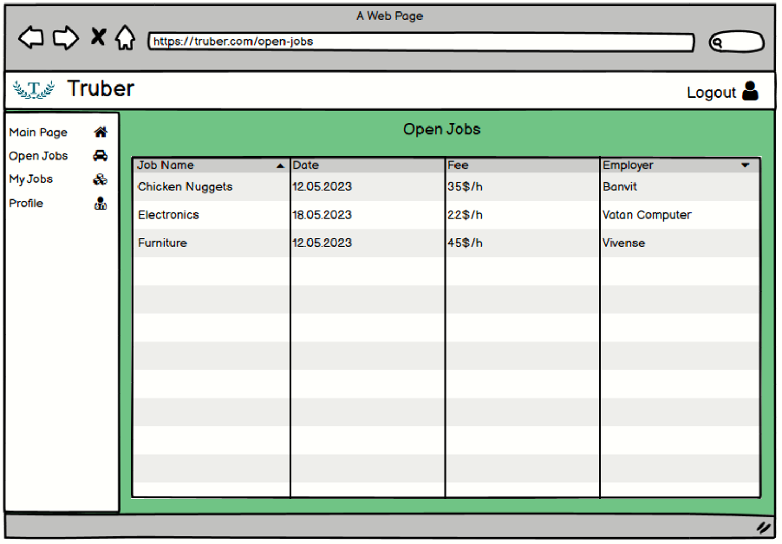
GUI | Open Jobs Page

Slide 31
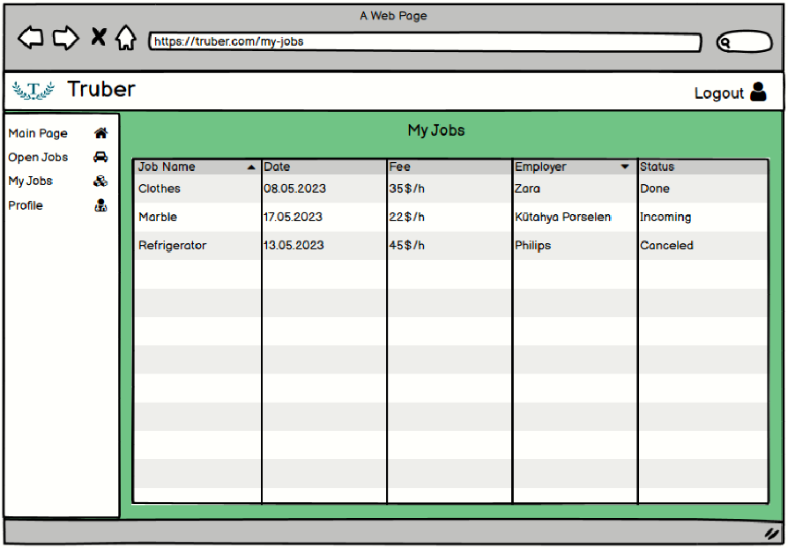
GUI | My Jobs Page

Slide 32
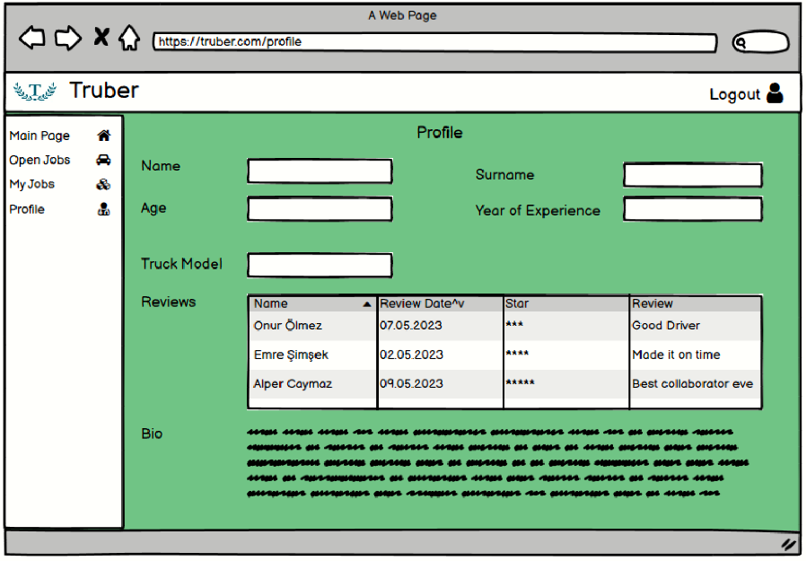
GUI | Profile Page

Slide 33

Conclusion

